Slide 1

Research Question – What is the correlation between the unemployment rate and various factors such as city, state, and year? Date: 21/11/2024
Group Name: A282 Name of Student Presenting: GUDEPU VINAY

Slide 2
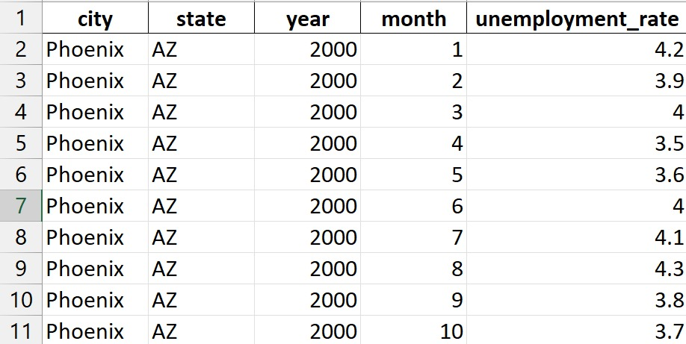
Snippet of our dataset (unemployment_rate)

Slide 3
The reason for choosing this dataset/topic could be to analyze trends, patterns, and factors influencing unemployment rates. This helps in understanding economic conditions, making policy decisions, or identifying areas requiring intervention for job creation. Our Independent variable is: city,state,year,month. This Independent variable datatype is : Interval Our Dependent variable is: unemployment rate . This Dependent variable datatype is : Interval
Dataset ID: DS237(unemployment rate)
Notes:
Before specifying your Research Question you must define the type of data you are analysing. Are the variables you select interval data (measurement data you can divide, multiple, etc), OR are they ordinal (there is a definite order but the intervals between each variable are not necessarily equal, or the terms might be subjective like in a likert scale); OR are they just categorical/nominal (Items such as film names, cities, etc., that you can count numbers of occurrences? You also need to understand whether the variable is either dependent or independent and this will vary according to the context. Independent variables may cause an effect, whereas the dependent variable might be effected by the independent variable. Check the lecture notes on the RQ for more information and examples.
You will get only one opportunity to present your Research Question ahead of the submission date. Have your questions ready, and be ready to take notes on feedback.

Slide 4
Our Research Question is:
What is the correlation between the unemployment
rate and various factors such as city, state, and year?

Slide 5
Null hypothesis (H₀):
There doesn't appear to be a strong connection between the unemployment rate and factors like city, state, or year.
2. Alternative hypothesis (H₁):
A clear correlation exists between the unemployment rate and factors like city, state, and year.

